Slide 1
Optimizing Software Performance using Tools like Prometheus and Grafana

Slide 2
Introduction to Software Performance Optimization
Importance of software performance in modern applications
Challenges in monitoring and optimizing performance
Overview of Prometheus and Grafana as performance monitoring tools

Slide 3
What is Prometheus?
Open-source monitoring and alerting toolkit
Developed by SoundCloud, now a CNCF project
Used for collecting and storing time-series data
Key features: Multi-dimensional data model, powerful queries, alerting mechanism

Slide 4
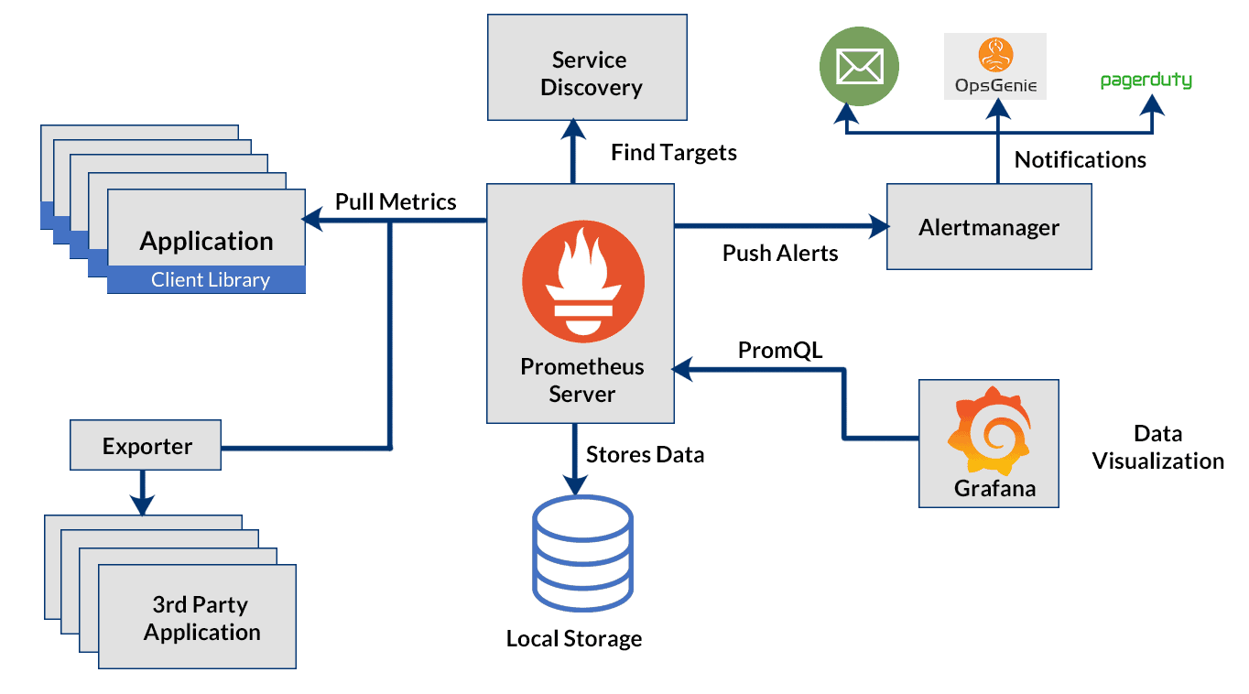

Slide 5
What is Grafana?
Open-source analytics and visualization tool
Used to create interactive dashboards for monitoring
Supports multiple data sources (Prometheus, InfluxDB, Elasticsearch, etc.)
Provides real-time data insights with customizable graphs and alerts

Slide 6
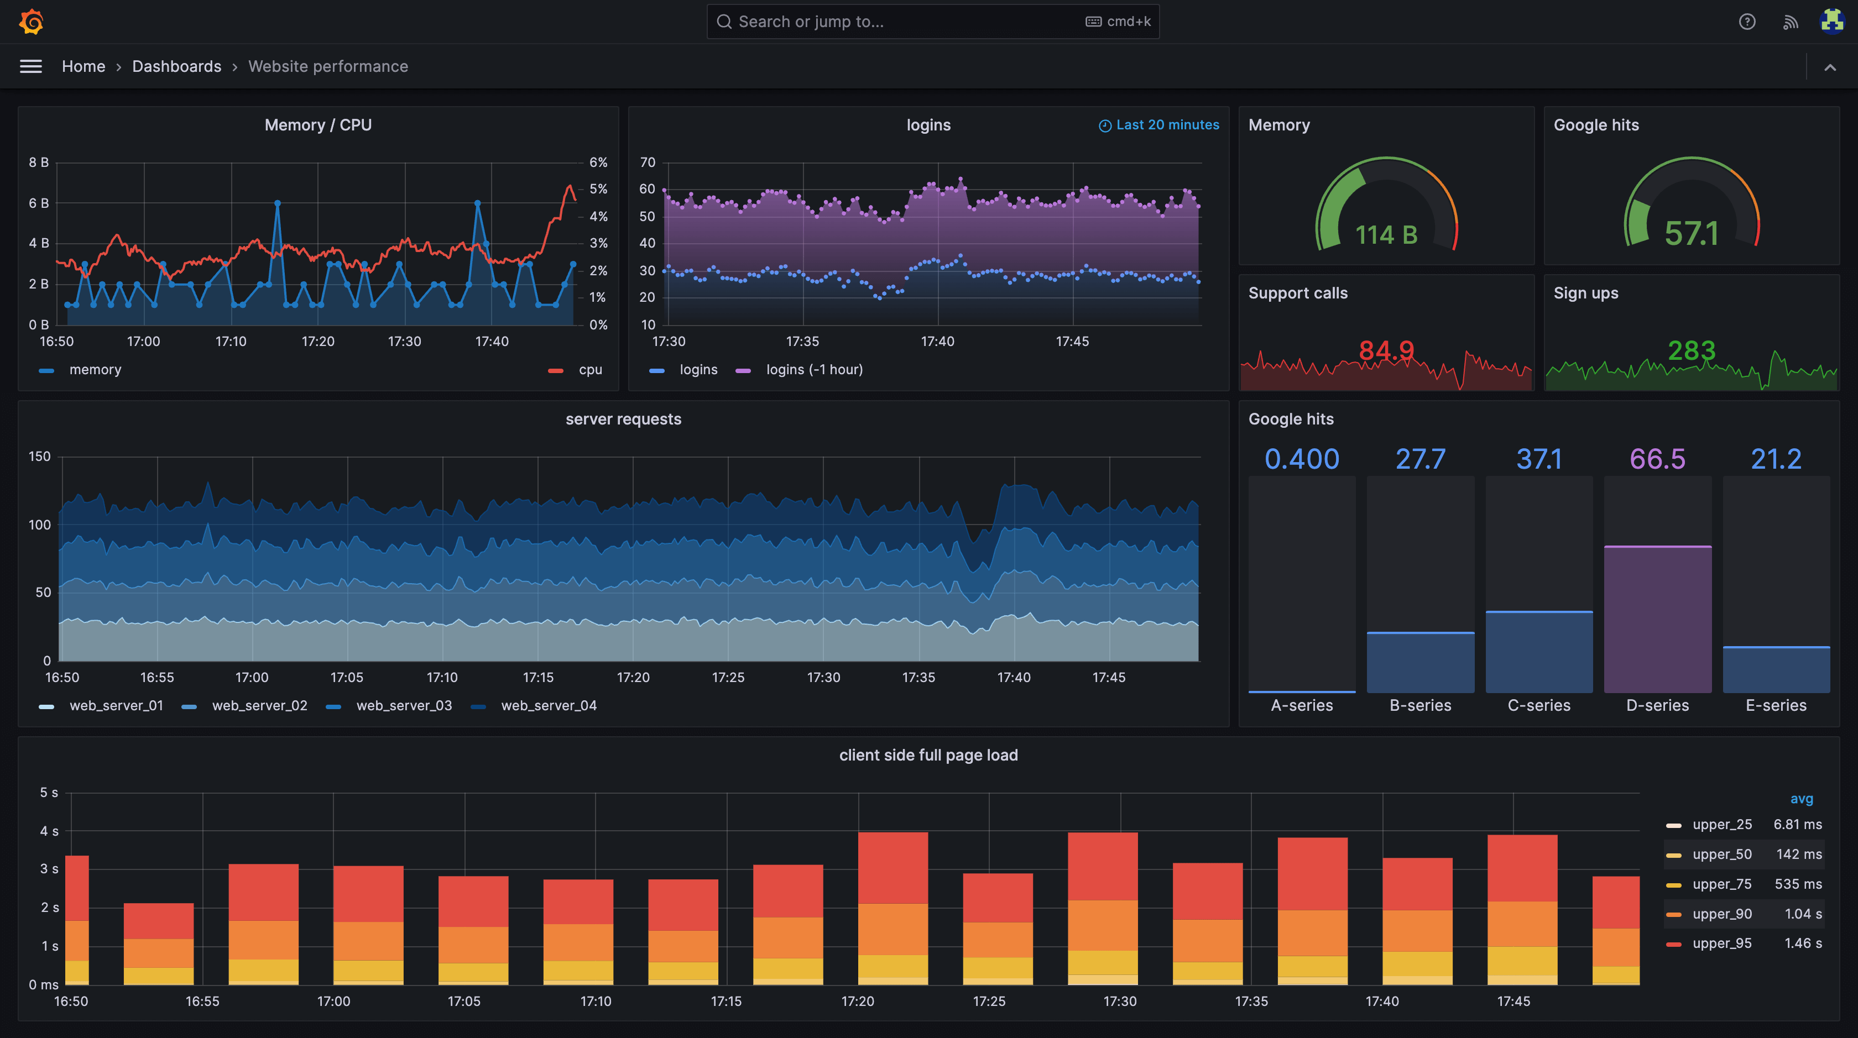

Slide 7
How Prometheus and Grafana Work Together
Prometheus collects and stores time-series data
Grafana retrieves data from Prometheus and visualizes it
Alerts can be set up in Prometheus and displayed in Grafana

Slide 8
Key Metrics for Performance Optimization
CPU and Memory Usage
Request Latency
Error Rates
Throughput (Requests Per Second)
Disk and Network Utilization

Slide 9
Setting Up Prometheus
Install Prometheus on the server
Configure Prometheus YAML file (prometheus.yml)
Define scrape jobs to collect metrics
Start Prometheus and access it via the web interface

Slide 10
Setting Up Grafana
Install Grafana on the server
Configure data source (Prometheus)
Create dashboards with metrics visualization
Set up alerting for performance anomalies

Slide 11
Use Case - Monitoring a Web Application
Track API response times and error rates
Visualize CPU and memory usage trends
Set up alerts for performance degradation

Slide 12
Benefits of Using Prometheus and Grafana
Real-time monitoring and alerting
Open-source and community-supported
Scalable for large distributed systems
Highly customizable and extensible

Slide 13
Challenges and Best Practices
Managing high volumes of metrics efficiently
Optimizing query performance in Prometheus
Properly configuring alerts to reduce noise
Regularly updating dashboards for better insights

Slide 14
Conclusion
Prometheus and Grafana are powerful tools for performance monitoring
Proper setup and configuration lead to better application reliability
Continuous monitoring ensures software efficiency and user satisfaction

